Slide 1
Presentation on Bangladesh

Slide 2
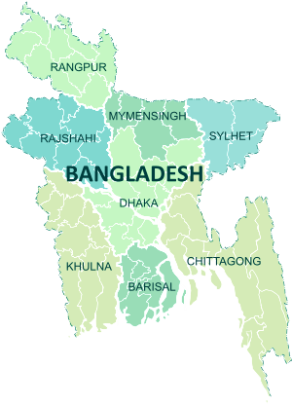
History
The history of Bangladesh dates back over four millennia to the Chalcolithic period. The region's early history was characterized by a succession of Hindu and Buddhist kingdoms and empires that fought for control over the Bengal region. Islam arrived in the 8th century and gradually became dominant from the early 13th century with the conquests led by Bakhtiyar Khalji in 1204 and the activities of Sunni missionaries like Shah Jalal. Muslim rulers promoted the spread of Islam by building mosques across the region. In 1338 Fakhruddin Mubarak Shah established independent sultanate in Bengal, establishing the capital at Sonargaon and founded an individual currency. The Bengal Sultanate expanded under rulers like Shamsuddin Ilyas Shah, leading to economic prosperity and military dominance, with Bengal being referred to by Europeans as the richest country to trade with. The region later became a part of the Mughal Empire. By the 18th century, Mughal Bengal emerged as the wealthiest province of the empire.

Slide 3
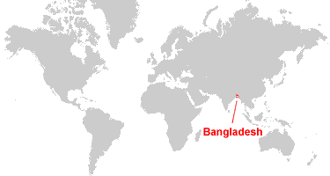
Government and Politics
Bangladesh, by constitution, is a unitary state^{[77]} and a de jure representative democracy with a Westminster-style parliamentary system^{[78]} that has universal suffrage.^{[79]} The government can be divided into three pillars: the executive, the legislative and the judiciary—all function harmoniously to ensure accountability, transparency and checks and balances of the government.^{[77]} Since its independence, the Awami League (AL) and the Bangladesh Nationalist Party (BNP) have remained two of the most powerful political parties in Bangladesh.^{[78]}
The first pillar of the government is the executive organ, which is entrusted with the total administration of the country.^{[77]} Executive powers are largely vested in the Prime Minister, who is the head of government, and oversees the cabinet.^{[77]} The tenure of a parliamentary government is five years. Various ministers form the bulk of the executive organ, overseeing government departments and forming policies.^{[77]} The Civil Service assists the ministers in implementing the policies.^{[77]} All authorities unite to formulate policies, manage public services, and implement national development plans.^{[77]} The President is the ceremonial head of state, whose powers include signing bills passed by parliament into law and maintaining the government's stability and continuity;^{[77]} as well as fulfilling their duties as the commander-in-chief of the Armed Forces^{[80]} and the chancellor of all universities.^{[81]}

Slide 4
Bangladesh
Dhaka
Barishal
Chittagong
Rajshahi
Rangpur
Sylhet
Khulna
Mymensingh
Division of Bangladesh

Slide 5
Division | Capital | Stablishment | Area | Population | Density
Barishal Divisioin | Barishal | 1 January 1993 | 13,225 | 13,225 | 734
Chittagong Divisioin | Chittagong | 1 January 1829 | 33,909 | 33,909 | 1,025
Dhaka Divisioin | Dhaka | 1 January 1829 | 20,594 | 20,594 | 2,069
Rangpur Divisioin | Rangpur | 25 January 2010 | 16,185 | 22,284 | 817
Syleht Divisioin | Syleht | 1 August 1995 | 12,635 | 10,584 | 1,271
Khulna Divisioin | Khulna | 1 October 1960 | 22,284 | 18,153 | 1,190
Mymensigh Divisioin | Mymensigh | 14 September 2015 | 10,584 | 16,185 | 1,166
Rajshahi Divisioin | Rajshahi | 1 January 1829 | 18,153 | 12,635 | 986

Slide 6





Scenario of Bangladesh

Slide 7
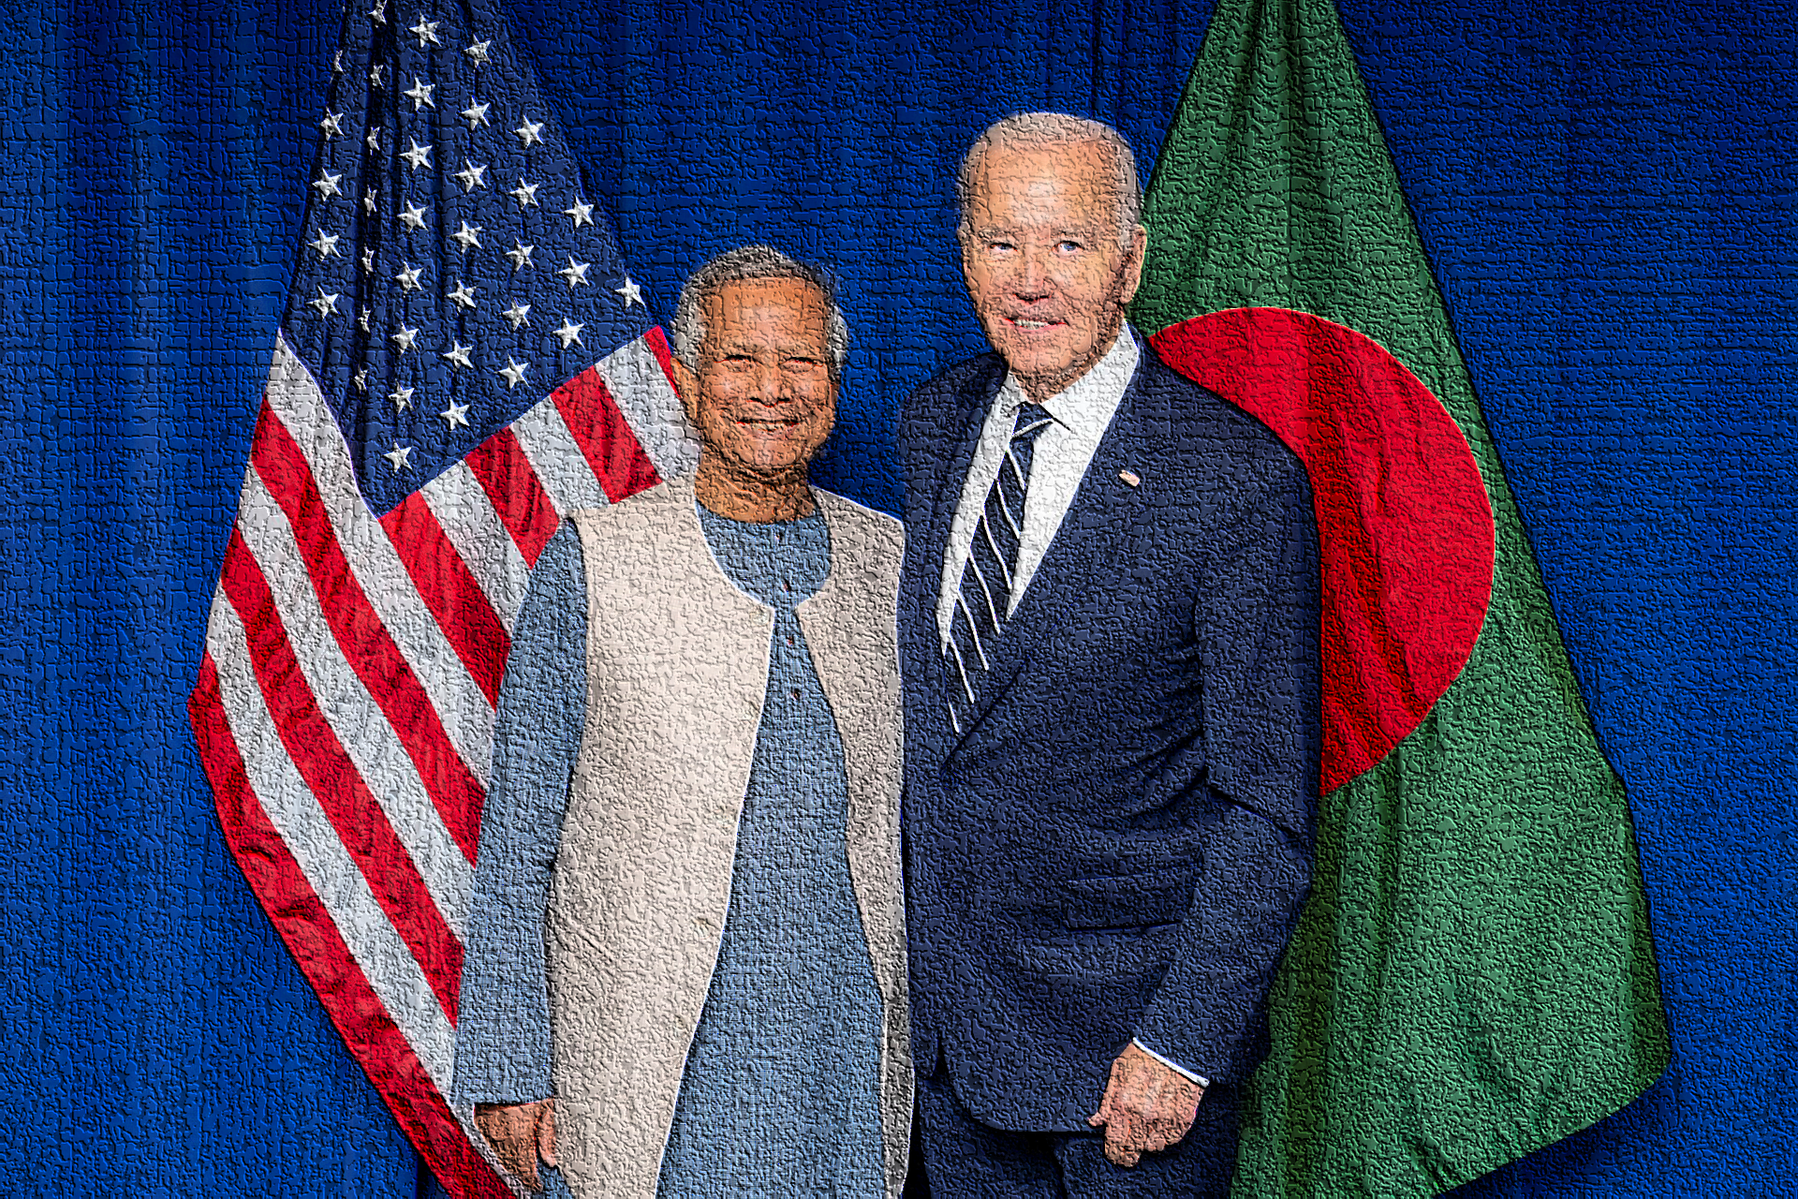
Foreign Relations
Bangladesh is considered a middle power in global politics.^{[95]} It plays an important role in the geopolitical affairs of the Indo-Pacific,^{[96]} due to its strategic location between South and Southeast Asia.^{[97]} Bangladesh joined the Commonwealth of Nations in 1972 and the United Nations in 1974.^{[98][99]} It relies on multilateral diplomacy on issues like climate change, nuclear nonproliferation, trade policy and non-traditional security issues.^{[100]} Bangladesh pioneered the creation of SAARC, which has been the preeminent forum for regional diplomacy among the countries of the Indian subcontinent.^{[101]} It joined the OIC in 1974,^{[102]} and is a founding member of the Developing-8.^{[103]} In recent years,
Relations with neighbouring Myanmar have been severely strained since 2016–2017, after over 700,000 Rohingya refugees illegally entered Bangladesh.^{[105]} The parliament, government, and civil society of Bangladesh have been at the forefront of international criticism against Myanmar for military operations against the Rohingya, and have demanded their right of return to Arakan.

Slide 8
Economy
Bangladesh's lower-middle income mixed-market economy is among the fastest growing economies in the world.^{[168][169]} A rapidly developing country, it has the world's 36th-largest economy by nominal terms, and the 24th-largest by PPP. Bangladesh has a labor force of 71.4 million,^{[170]} which is the world's seventh-largest; with an unemployment rate of 5.1% as of 2023.^{[171]} Its foreign exchange reserves, although depleting,^{[172]} remain the second-highest in South Asia, after India. Bangladesh's large diaspora contributed roughly $27 billion in remittances in 2024.^{[173]} The Bangladeshi taka is the national currency. include shipbuilding, pharmaceuticals, steel, electronics and leather goods.^{[183]} China is the largest trading partner of Bangladesh, accounting for 15% of the total trade, followed by India; which accounts for 8% of the total trade.^{[184]}

Slide 9
Language
The official and predominant language of Bangladesh is Bengali, which is spoken by more than 99% of the population as their native language.^{[223][224]} Bengali is described as a dialect continuum where there are various dialects spoken throughout the country. There is a diglossia in which much of the population can understand or speak in Standard Colloquial Bengali, and in their regional dialect or language.^{[225]} These include Chittagonian which is spoken in the southeastern region of Chittagong,^{[226]} Noakhali spoken in the southern district of Noakhali^{[227][228]} and Sylheti spoken in the northeastern region of Sylhet.^{[224]}
English plays an important role in Bangladesh's judicial and educational affairs, due to the country's history as part of the British Empire. It is widely spoken and commonly understood, and is taught as a compulsory subject in all schools, colleges and universities, while the English-medium educational system is widely attended.^{[229]}

Slide 10
The End

